Slide 1
Introduction to 8086 Microprocessor

Slide 2
8086 Microprocessor features
8086 is an enhanced version of 8085 that has been developed by Intel in 1978.
It is 16-bit microprocessor, executes at 2.5 MIPS.
It has a 16-bit data bus, so it can read data from or write data to memory and ports either 16-bit or 8-bit at a time.
It has 20 bit address bus and can access up to 2²⁰ memory locations (1 MB).
It can support up to 64K I/O ports

Slide 3
8086 Microprocessor features
It provides 14, 16-bit registers
It has multiplexed address and data bus AD0-AD15 and A16-A19
Pre-fetches up to 6 instruction bytes from memory and queues them in order to speed up the processing

Slide 4
8086 Microprocessor features
It supports two modes of operation: first is maximum mode and second is minimum mode. Minimum mode is applicable for system that has a single processor and maximum mode is used for the multiprocessor system.

Slide 5
Architecture of 8086 microprocessor
The 8086 CPU is divided into two independent functional units:
Bus Interface Unit (BIU)
Execution Unit (EU)
The BIU has to interact with memory and input and output devices in fetching the instructions and data required by the EU
EU is responsible for executing the instructions of the programs and to carry out the required processing

Slide 7
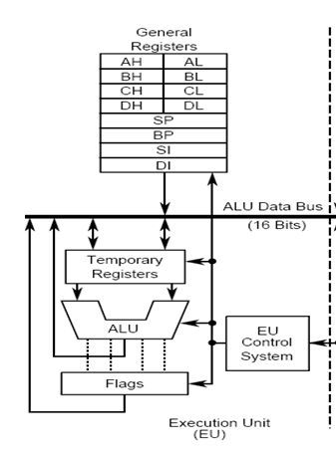
Execution Unit
The Execution Unit (EU) has
Control unit
Instruction decoder
Arithmetic and Logical Unit (ALU)
General purpose registers
Flag register
Pointers
Index registers

Slide 8
Execution Unit
The execution unit of the 8086 tells the BIU where to fetch instructions or data from, decodes instructions, and executes instructions.
The EU contains control circuitry, which directs internal operations.
A decoder in the EU translates instructions fetched from memory into a series of actions

Slide 9
The EU has a 16-bit arithmetic logic unit (ALU) which can add, subtract, AND, OR, XOR, increment, decrement, complement or shift binary numbers.

Slide 10
Each register has some special functions:
AX/AL: Used as accumulator. Used in multiply, divide and I/O operations
BX: Used to hold the offset address of a location in memory.
CX: Used to hold the count value in string/loop instructions
DX: Used to hold a part of the result during multiplication operation and also a part of the dividend before the division operation

Slide 11
Each register has some special functions:
SP: Used to hold the offset address of the data stored at the top of the stack segment
BP: It holds the offset address of the source data in the data segment
SI: Used to hold the offset address of source data in data segment
DI: Used to hold the offset address of destination data in extra segment

Slide 12
8086 flag register
A 16 bit flag register is used in 8086. It is divided into two parts .
Condition code or status flags
Machine control flags
The condition code flag register is the lower byte of the 16-bit flag register.
Identical to 8085 flag register, with an additional overflow flag.
The control flag register is the higher byte of the flag register.
It contains three flags : direction flag (D), interrupt flag (I) and trap flag (T).

Slide 13
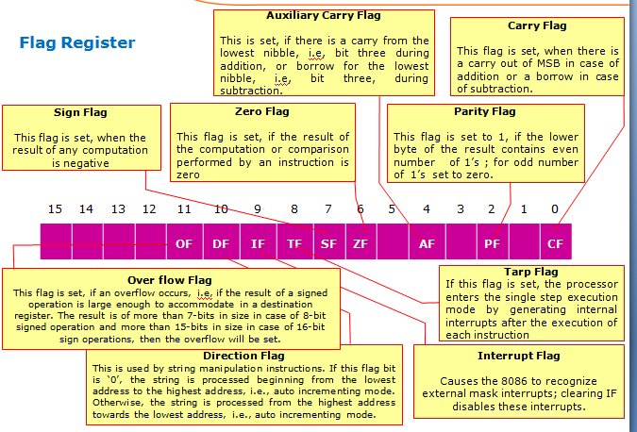

Slide 14
Function of Execution Unit
The main functions of EU are:
Decoding of Instructions
Execution of instructions
Steps
EU extracts instructions from top of queue in BIU
Decode the instructions
Generates operands if necessary
Passes operands to BIU and requests it to perform read or write bus cycles to memory or I/O
Perform the operation specified by the instruction on operands

Slide 15
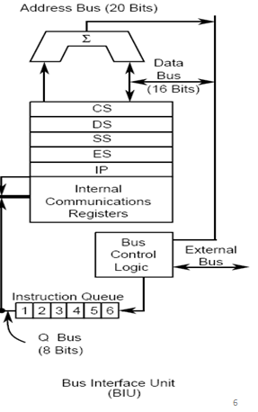
BIU
The BIU consists of
Instruction queue
Four 16 bit Segment Registers(CS, DS, SS, ES)
Instruction pointer and address summation

Slide 16
Bus Interface Unit (BIU)
The BIU handles all transfers of data and addresses on the buses for the execution unit.
The BIU sends out addresses, fetches instructions from memory, reads data from ports and memory, and writes data to ports and memory.

Slide 17
8086 Pipeline Architecture
Fetching the next instruction while the current instruction executes is called pipelining
While the EU is decoding an instruction or executing an instruction( which does not require use of the buses), the BIU fetches up to six instruction bytes for the following instructions.

Slide 18
8086 Pipeline Architecture
The BIU stores these pre-fetched bytes in a first-in-first-out register set called a queue.
When the EU is ready, it can fetch its next instruction from the queue in the BIU.
Except in the case of JMP and CALL instructions, where the queue must be discarded and then reloaded starting from a new address, this pre-fetch and queue scheme greatly speeds up processing.

Slide 19
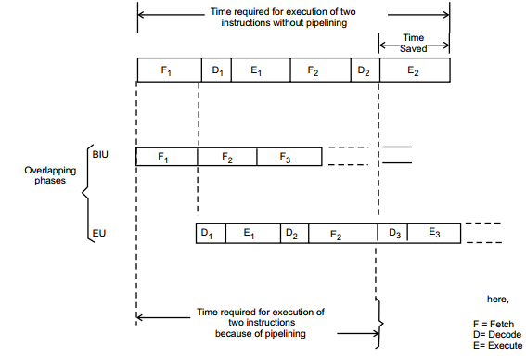

Slide 20
Because of the instruction queue, there is an overlap between the instruction execution and instruction fetching.
This feature of fetching the next instruction when the current instruction is being executed, is called Pipelining.

Slide 21
8086 Register organization
8086 has a powerful set of registers known as general purpose registers and special purpose registers
All of them are 16-bit registers.
Special purpose registers:
These registers are used as segment registers, pointers, index registers or as offset storage registers for particular addressing modes.

Slide 22
General purpose registers:
These registers can be used as either 8-bit registers or 16-bit registers.
They may be either used for holding data, variables and intermediate results temporarily or for other
purposes like a counter or for storing offset address for some particular addressing modes etc.

Slide 23
8086 Register organization
The 8086 registers are classified into the following types:
General Data Registers
Segment Registers
Pointers and Index Registers
Flag Register

Slide 24
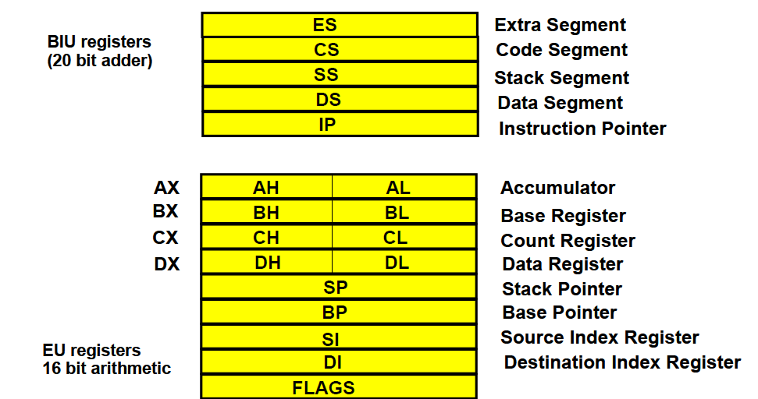

Slide 25
General Data Registers
The registers AX, BX, CX and DX are the general purpose 16-bit registers.
AX is used as 16-bit accumulator. The lower 8-bit is designated as AL and higher 8-bit is designated as AH.
AL can be used as an 8-bit accumulator for 8-bit operation.
All data register can be used as either 16 bit or 8 bit

Slide 26
The register BX is used as offset storage for forming physical address in case of certain addressing modes.
The register CX is used default counter in case of string and loop instructions.
DX register is a general purpose register which may be used as an implicit operand or destination in case of a few instructions.

Slide 27
Segment Registers:
There are 4 segment registers.
Code Segment Register(CS)
Data Segment Register(DS)
Extra Segment Register(ES)
Stack Segment Register(SS)

Slide 28
Code segment register (CS): is used for addressing memory location in the code segment of the memory, where the executable program is stored.
Data segment register (DS): points to the data segment of the memory where the data is stored.
Extra Segment Register (ES) : also refers to a segment in the memory which is another data segment in the memory

Slide 29
Stack Segment Register (SS): is used for addressing stack segment of the memory.
The stack segment is that segment of memory which is used to store stack data.

Slide 30
Pointers and Index Registers
The index and pointer registers are given below:
IP—Instruction pointer-store memory location of next instruction to be executed
BP—Base pointer
SP—Stack pointer
SI—Source index
DI—Destination index

Slide 31
The pointers registers contain offset within the particular segments.
The pointer register IP contains offset within the code segment.
The pointer register BP contains offset within the data segment.
Thee pointer register SP contains offset within the stack segment.

Slide 32
The index registers are used as general purpose registers as well as for offset storage in case of indexed, base indexed and relative base indexed addressing modes.
The register SI is used to store the offset of source data in data segment.
The register DI is used to store the offset of destination in data or extra segment

Slide 33
The 8086 architecture uses the concept of segmented memory.
8086 able to address a memory capacity of 1 megabyte and it is byte organized.
This 1 megabyte memory is divided into 16 logical segments.
Each segment contains 64 KBs of memory.

Slide 34
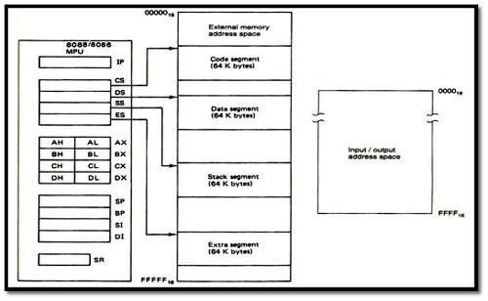

Slide 35
The 16-bit contents of segment register gives the starting/ base address of particular segment.
To address a specific memory location within a segment we need an offset address.
The offset address is also 16-bit wide and it is provided by one of the associated pointer or index register.

Slide 36
Logical and Physical Address
Addresses within a segment can range from address 00000H to address 0FFFFH.
This corresponds to the 64K-bytelength of the segment.
An address within a segment is called an offset or logical address.
The physical address is 20 bits long and corresponds to the actual binary code output by the BIU on the address bus lines.

Slide 37
While addressing any location in the memory bank, the physical address is calculated from two parts:
Physical address= segment address + offset address
The first is segment address, the segment registers contain 16-bit segment base addresses, related to different segment.
The second part is the offset value in that segment.

Slide 38
A segment number is a 16 bit number
Segment numbers range from 0000 to FFFF
Within a segment, a particular memory location is specified with an offset
An offset also ranges from 0000 to FFFF

Slide 39
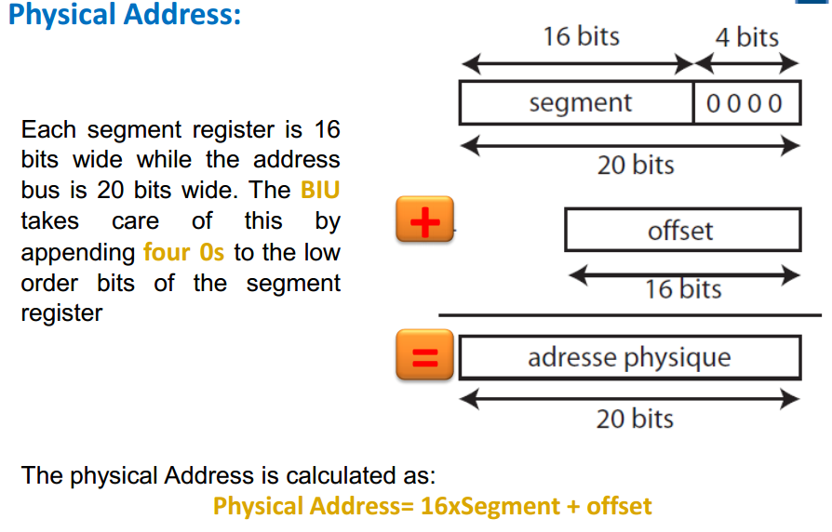

Slide 40
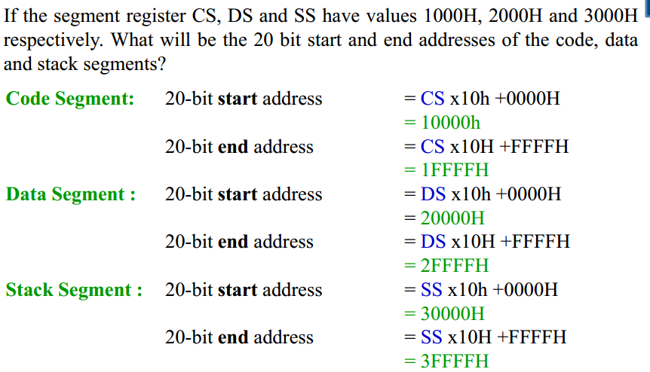
Example

Slide 41
Segment registers and default offset register in 8086
Segment registers default offset register
CS IP
DS BX, SI, DI, 8 or 16 bit disp.
SS SP and BP
ES DI for string operation

Slide 42
Example
If the CS register has value 3000H and IP has the value 2000H, Physical address (memory address from where next instruction is taken) is computed as:
CS×10H=30000H (Base address of code segment)
+ IP = 2000H (offset address)
_______
32000H (Physical address )

Slide 43
Example
If the DS register has value 1000H and BX has the value 3000H, Physical address (memory address from where next instruction is taken) is computed as:
DS×10H=10000H (Base address of data segment)
+ BX = 3000H (offset address)
___________
13000H (Physical address )

Slide 44
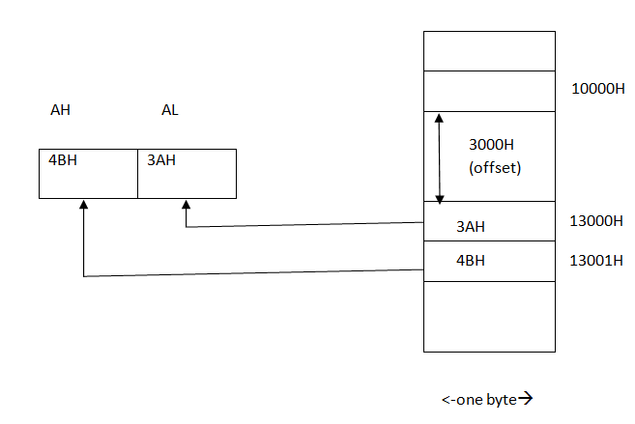
This can be explained by the execution of instruction MOV AX, [BX]

